Slide 1
ECON 6010 Statistical Methods
Dr. Fadi Fawaz
Department of Economics and Finance
Tennessee State University©
Forecasting

Slide 2
Objectives
Give the fundamental rules of forecasting
Calculate a forecast using a moving average, weighted moving average, and exponential smoothing
Calculate the accuracy of a forecast

Slide 3

What is forecasting?
Forecasting is a tool used for predicting
future demand based on
past demand information.

Slide 4
Why is forecasting important?
Demand for products and services is usually uncertain.
Forecasting can be used for…
Strategic planning (long range planning)
Finance and accounting (budgets and cost controls)
Marketing (future sales, new products)
Production and operations

Slide 5
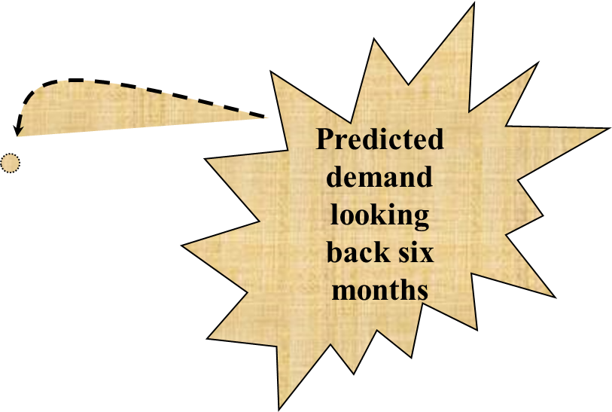
What is forecasting all about?
Demand for Mercedes E Class
We try to predict the future by looking back at the past
Time
Jan
Feb
Mar
Apr
May
Jun
Jul
Aug
Actual demand (past sales)
Predicted demand

Slide 6
What’s Forecasting All About?
From the March 10, 2006 WSJ:
Ahead of the Oscars, an economics professor, at the request of Weekend Journal, processed data about this year's films nominated for best picture through his statistical model and predicted with 97.4% certainty that "Brokeback Mountain" would win. Oops. Last year, the professor tuned his model until it correctly predicted 18 of the previous 20 best-picture awards; then it predicted that "The Aviator" would win; "Million Dollar Baby" won instead.
Sometimes models tuned to prior results don't have great predictive powers.

Slide 7
Some general characteristics of forecasts
Forecasts are always wrong
Forecasts are more accurate for groups or families of items
Forecasts are more accurate for shorter time periods
Every forecast should include an error estimate
Forecasts are no substitute for calculated demand.

Slide 8
Key issues in forecasting
A forecast is only as good as the information included in the forecast (past data)
History is not a perfect predictor of the future (i.e.: there is no such thing as a perfect forecast)
REMEMBER: Forecasting is based on the assumption that the past predicts the future! When forecasting, think carefully whether or not the past is strongly related to what you expect to see in the future…

Slide 9
Example: Mercedes E-class vs. M-class Sales
Month | E-class Sales | M-class Sales
Jan | 23,345 | -
Feb | 22,034 | -
Mar | 21,453 | -
Apr | 24,897 | -
May | 23,561 | -
Jun | 22,684 | -
Jul | ? | ?
Question: Can we predict the new model M-class sales based on the data in the table?
Answer: Maybe... We need to consider how much the two markets have in common

Slide 10
What should we consider when looking at
past demand data?
Trends
Seasonality
Cyclical elements
Autocorrelation
Random variation

Slide 11
Some Important Questions
What is the purpose of the forecast?
Which systems will use the forecast?
How important is the past in estimating the future?
Answers will help determine time horizons, techniques, and level of detail for the forecast.

Slide 12
Types of forecasting methods
Qualitative methods
Quantitative methods
Rely on subjective opinions from one or more experts.
Rely on data and analytical techniques.

Slide 13
Qualitative forecasting methods
Grass Roots: deriving future demand by asking the person closest to the customer.
Market Research: trying to identify customer habits; new product ideas.
Panel Consensus: deriving future estimations from the synergy of a panel of experts in the area.
Historical Analogy: identifying another similar market.
Delphi Method: similar to the panel consensus but with concealed identities.

Slide 14
Quantitative forecasting methods
Time Series: models that predict future demand based on past history trends
Causal Relationship: models that use statistical techniques to establish relationships between various items and demand
Simulation: models that can incorporate some randomness and non-linear effects

Slide 15
How should we pick our forecasting model?
Data availability
Time horizon for the forecast
Required accuracy
Required Resources

Slide 16
Time Series: Moving average
The moving average model uses the last t periods in order to predict demand in period t+1.
There can be two types of moving average models: simple moving average and weighted moving average
The moving average model assumption is that the most accurate prediction of future demand is a simple (linear) combination of past demand.

Slide 17
Time series: simple moving average
In the simple moving average models the forecast value is
A_{t} + A_{t-1} + … + A_{t-n}
F_{t+1} =
n
t is the current period.
F_{t+1} is the forecast for next period
n is the forecasting horizon (how far back we look),
A is the actual sales figure from each period.

Slide 18
Example: forecasting sales at Kroger
Kroger sells (among other stuff) bottled spring water
What will the sales be for July?
Month | Bottles
Jan | 1,325
Feb | 1,353
Mar | 1,305
Apr | 1,275
May | 1,210
Jun | 1,195
Jul | ?

Slide 19
What if we use a 3-month simple moving average?
A_{Jun} + A_{May} + A_{Apr}
F_{Jul} =
= 1,227
3
What if we use a 5-month simple moving average?
A_{Jun} + A_{May} + A_{Apr} + A_{Mar} + A_{Feb}
F_{Jul} =
= 1,268
5

Slide 20
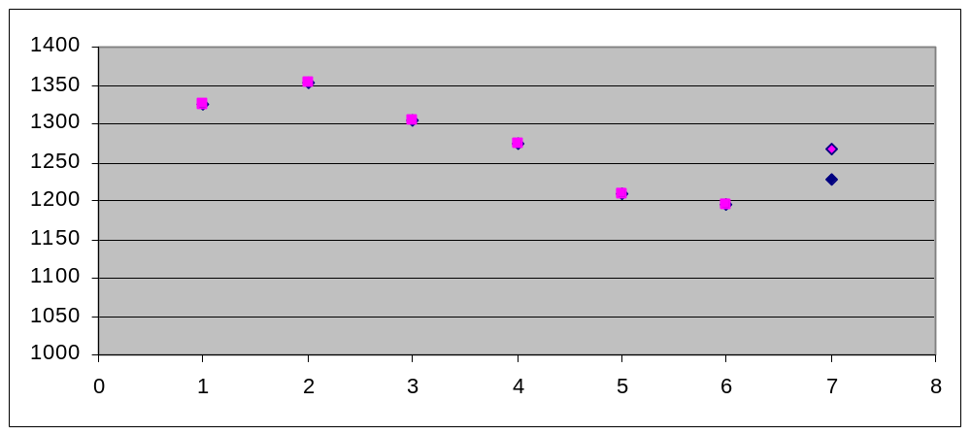
5-month
MA forecast
3-month
MA forecast
What do we observe?
5-month average smoothes data more;
3-month average more responsive

Slide 21
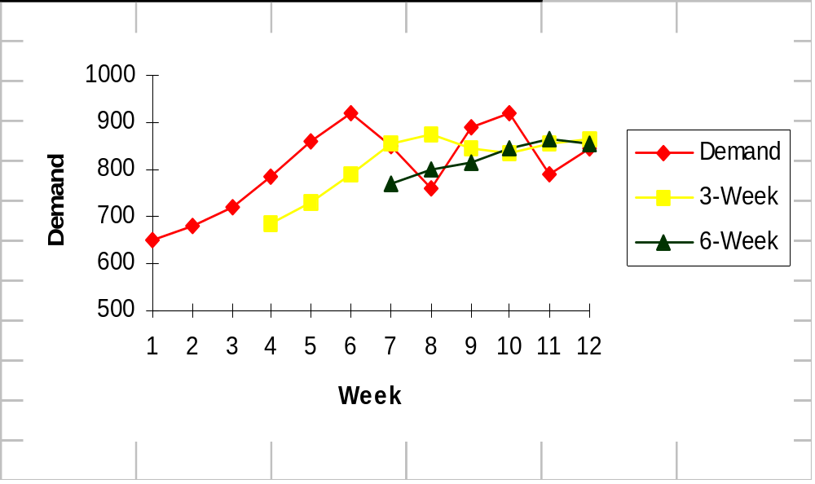
Stability versus responsiveness in moving averages

Slide 22
Time series: weighted moving average
We may want to give more importance to some of the data…
F_{t+1} =
w_{t} A_{t} + w_{t-1} A_{t-1} + … + w_{t-n} A_{t-n}
w_{t} + w_{t-1} + … + w_{t-n} = 1
t is the current period.
F_{t+1} is the forecast for next period
n is the forecasting horizon (how far back we look),
A is the actual sales figure from each period.
w is the importance (weight) we give to each period

Slide 23
Why do we need the WMA models?
Because of the ability to give more importance to what happened recently, without losing the impact of the past.
Demand for Mercedes E-class
Actual demand (past sales)
Prediction when using 6-month SMA
Prediction when using 6-months WMA
For a 6-month SMA, attributing equal weights to all past data we miss the downward trend
Time
Jan
Feb
Mar
Apr
May
Jun
Jul
Aug

Slide 24
Example: Kroger sales of bottled water
What will be the sales for July?
Month | Bottles
Jan | 1,325
Feb | 1,353
Mar | 1,305
Apr | 1,275
May | 1,210
Jun | 1,195
Jul | ?

Slide 25
6-month simple moving average…
A_{Jun} + A_{May} + A_{Apr} + A_{Mar} + A_{Feb} + A_{Jan}
F_{Jul} =
= 1,277
6
In other words, because we used equal weights, a slight downward trend that actually exists is not observed…

Slide 26
What if we use a weighted moving average?
Make the weights for the last three months more than the first three months…
 | 6-month SMA | WMA 40% / 60% | WMA 30% / 70% | WMA 20% / 80%
July Forecast | 1,277 | 1,267 | 1,257 | 1,247
The higher the importance we give to recent data, the more we pick up the declining trend in our forecast.

Slide 27
How do we choose weights?
Depending on the importance that we feel past data has
Depending on known seasonality (weights of past data can also be zero).
WMA is better than SMA because of the ability to
vary the weights!

Slide 28
Time Series: Exponential Smoothing (ES)
Main idea: The prediction of the future depends mostly on the most recent observation, and on the error for the latest forecast.
Smoothing constant alpha α
Denotes the importance of the past error

Slide 29
Why use exponential smoothing?
Uses less storage space for data
Extremely accurate
Easy to understand
Little calculation complexity
There are simple accuracy tests

Slide 30
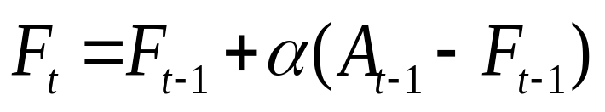
Exponential smoothing: the method
Assume that we are currently in period t. We calculated the forecast for the last period (F_{t-1}) and we know the actual demand last period (A_{t-1}) …
The smoothing constant α expresses how much our forecast will react to observed differences…
If α is low: there is little reaction to differences.
If α is high: there is a lot of reaction to differences.

Slide 31
Example: bottled water at Kroger
Month | Actual | Forecasted
Jan | 1,325 | 1,370
Feb | 1,353 | 1,361
Mar | 1,305 | 1,359
Apr | 1,275 | 1,349
May | 1,210 | 1,334
Jun | ? | 1,309
α = 0.2

Slide 32
Example: bottled water at Kroger
Month | Actual | Forecasted
Jan | 1,325 | 1,370
Feb | 1,353 | 1,334
Mar | 1,305 | 1,349
Apr | 1,275 | 1,314
May | 1,210 | 1,283
Jun | ? | 1,225
α = 0.8

Slide 33
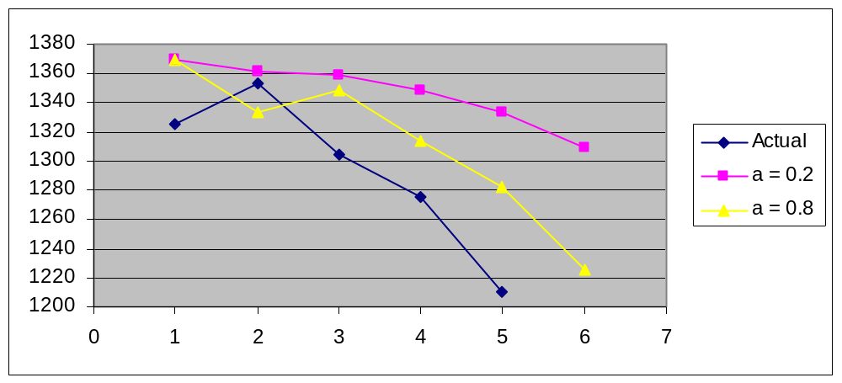
Impact of the smoothing constant

Slide 34
Trend..
What do you think will happen to a moving average or exponential smoothing model when there is a trend in the data?

Slide 35
Impact of trend
Sales
Regular exponential smoothing will always lag behind the trend.
Can we include trend analysis in exponential smoothing?
Actual Data
Forecast
Month

Slide 36
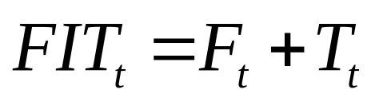
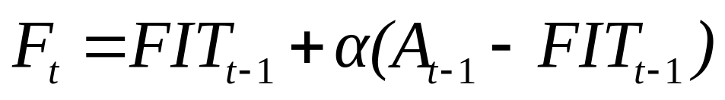
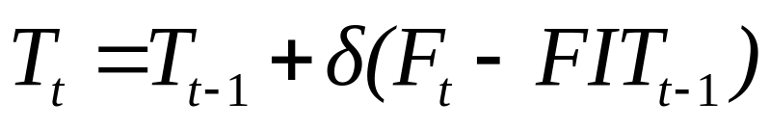
Exponential smoothing with trend
FIT: Forecast including trend
δ: Trend smoothing constant
The idea is that the two effects are decoupled,
(F is the forecast without trend and T is the trend component)

Slide 37
Example: bottled water at Kroger
 | A_{t} | F_{t} | T_{t} | FIT_{t}
Jan | 1325 | 1380 | -10 | 1370
Feb | 1353 | 1334 | -28 | 1306
Mar | 1305 | 1344 | -9 | 1334
Apr | 1275 | 1311 | -21 | 1290
May | 1210 | 1278 | -27 | 1251
Jun |  | 1218 | -43 | 1175
α = 0.8
δ = 0.5

Slide 38
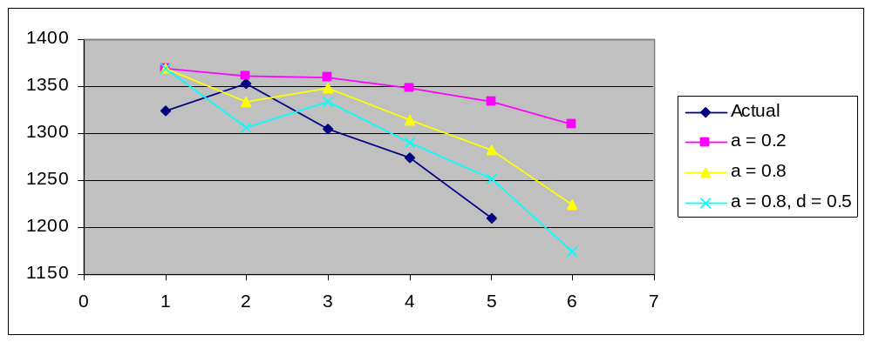
Exponential Smoothing with Trend

Slide 39
Linear regression in forecasting
Linear regression is based on
Fitting a straight line to data
Explaining the change in one variable through changes in other variables.
dependent variable = a + b × (independent variable)
By using linear regression, we are trying to explore which independent variables affect the dependent variable

Slide 40
Example: do people drink more when it’s cold?
Alcohol Sales
Which line best fits the data?
Average Monthly Temperature

Slide 41

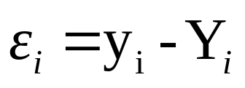
The best line is the one that minimizes the error
The predicted line is …
So, the error is …
Where: ε is the error
y is the observed value
Y is the predicted value

Slide 42
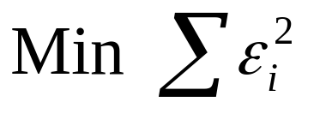
Least Squares Method of Linear Regression
The goal of LSM is to minimize the sum of squared errors…

Slide 43
What does that mean?
Alcohol Sales
ε
ε
ε
So LSM tries to minimize the distance between the line and the points!
Average Monthly Temperature

Slide 44
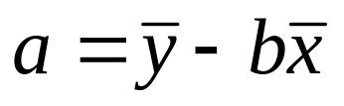
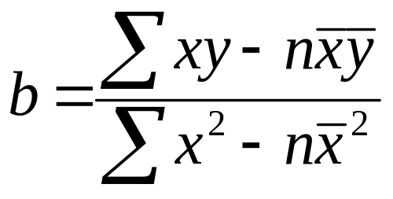
Least Squares Method of Linear Regression
Then the line is defined by

Slide 45
How can we compare across forecasting models?
We need a metric that provides estimation of accuracy
Forecast Error
Errors can be:
biased
random
Forecast error = Difference between actual and forecasted value (also known as residual)

Slide 46
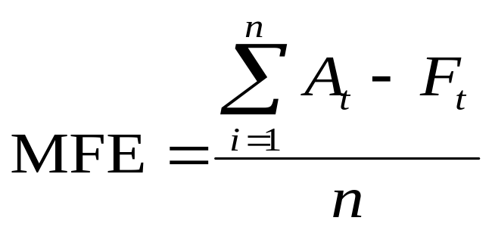
Measuring Accuracy: MFE
MFE = Mean Forecast Error (Bias)
It is the average error in the observations
1. A more positive or negative MFE implies worse performance; the forecast is biased.

Slide 47
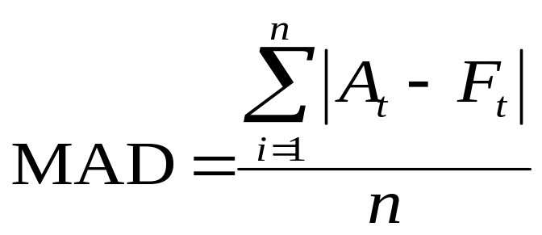
Measuring Accuracy: MAD
MAD = Mean Absolute Deviation
It is the average absolute error in the observations
1. Higher MAD implies worse performance.
2. If errors are normally distributed, then σ_{ε}=1.25MAD

Slide 48
Key Point
Forecast must be measured for accuracy!
The most common means of doing so is by measuring the either the mean absolute deviation or the standard deviation of the forecast error

Slide 49
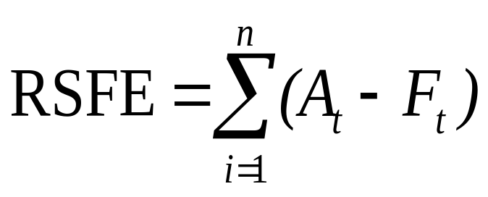
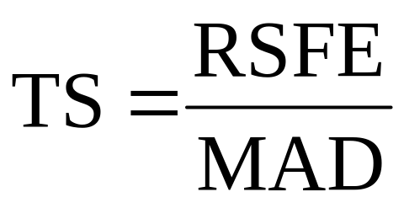
Measuring Accuracy: Tracking signal
The tracking signal is a measure of how often our estimations have been above or below the actual value. It is used to decide when to re-evaluate using a model.
Positive tracking signal: most of the time actual values are above our forecasted values
Negative tracking signal: most of the time actual values are below our forecasted values
If TS > 4 or < -4, investigate!

Slide 50
Example: bottled water at Kroger
Month | Actual | Forecast
Jan | 1,325 | 1,370
Feb | 1,353 | 1,361
Mar | 1,305 | 1,359
Apr | 1,275 | 1,349
May | 1,210 | 1,334
Jun | 1,195 | 1,309
Month | Actual | Forecast
Jan | 1,325 | 1370
Feb | 1,353 | 1306
Mar | 1,305 | 1334
Apr | 1,275 | 1290
May | 1,210 | 1251
Jun | 1,195 | 1175
Exponential Smoothing
(α = 0.2)
Forecasting with trend
(α = 0.8)
(δ = 0.5)
Question: Which one is better?

Slide 51
Bottled water at Kroger: compare MAD and TS
 | MAD | TS
Exponential Smoothing | 70 | - 6.0
Forecast Including Trend | 33 | - 2.0
We observe that FIT performs a lot better than ES
Conclusion: Probably there is trend in the data which
Exponential smoothing cannot capture

Slide 52
Which Forecasting Method Should You Use
Gather the historical data of what you want to forecast
Divide data into initiation set and evaluation set
Use the first set to develop the models
Use the second set to evaluate
Compare the MADs and MFEs of each model

